Slide 1
EXTREME AQUATIC ENVIRONMENTS
GROUP 33

Slide 2
OUTLINE
INTRODUCTION
TYPES OF EXTREME AQUATIC ENVIRONMENTS
DEEP OCEAN TRENCHES
HYDROTHERMAL VENTS
HYPERSALINE LAKES
EPHEMERAL AND INTERMITTENT WATER BODIES
ESTUARIES
CONCLUSION

Slide 3
INTRODUCTION
For an environment (E) to be considered extreme (E), it must contain certain conditions such as high temperature and high pressure that makes it very hard for other life forms to survive.
Thus an EE is marked by a peculiar set of biota.
If such an environment is found in water, then it is considered an extreme aquatic environment.

Slide 4
TYPES OF EXTREME AQUATIC ENVIRONMENTS
Deep Ocean Trenches
Geothermal Vents
Hypersaline Lakes
Ephemeral and Intermittent Water Bodies
Estuaries

Slide 5
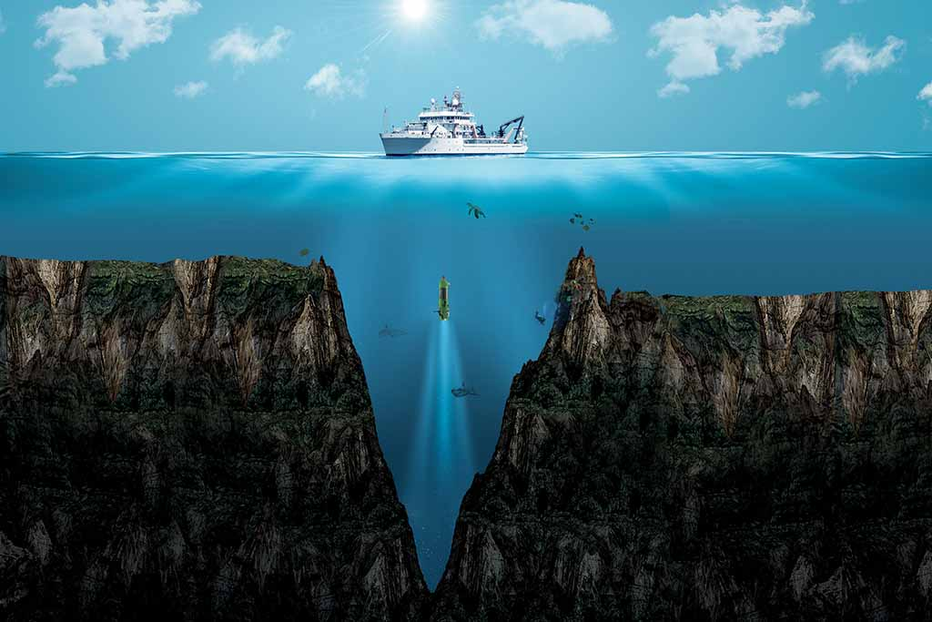
DEEP OCEAN TRENCHES
Deep Ocean trench

Slide 6
DEEP OCEAN TRENCHES; What are they?
Prominent, long, narrow depressions of the ocean floor.
Typically 3 to 4 km below the level of the surrounding oceanic floor.
Can be thousands of kilometers deep.
The deepest is the Mariana Trench (11022 meters)

Slide 7
DEEP OCEAN TRENCHES; Features
High hydrostatic pressure
Low radiant energy
Low visibility
Low food availability
Low temperature (usually)

Slide 8
DEEP OCEAN TRENCHES; Adaptations
Ability to withstand high pressure
Chemosynthesis. E.g. Sulphur bacteria
Detritivorous mode of nutrition E.g. Sea cucumber
Bioluminescence as a mode of communication E.g. Angler fish
Electrical modes of communication and detecting prey, using ampullae of Lorenzini E.g. Goblin shark

Slide 9
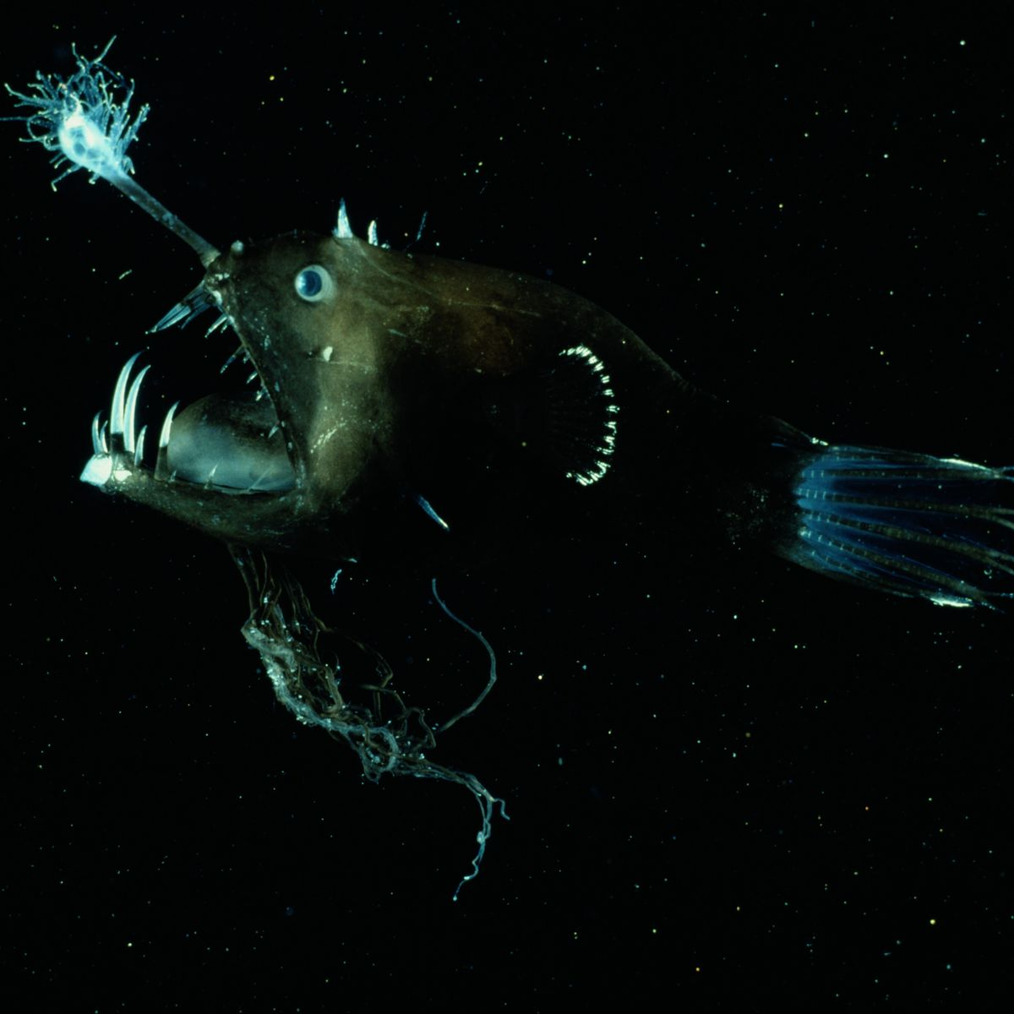
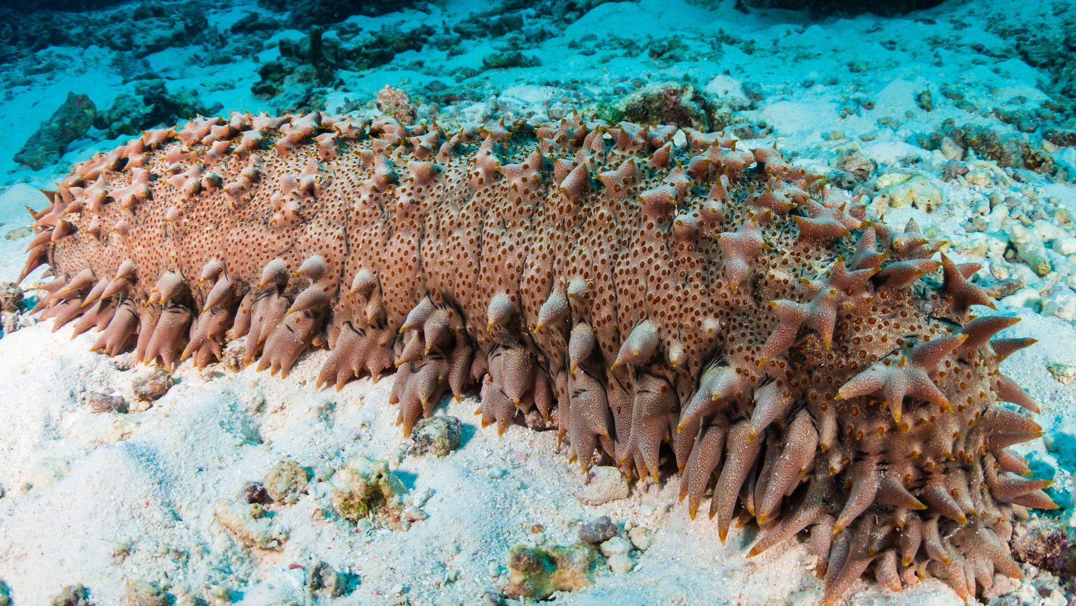
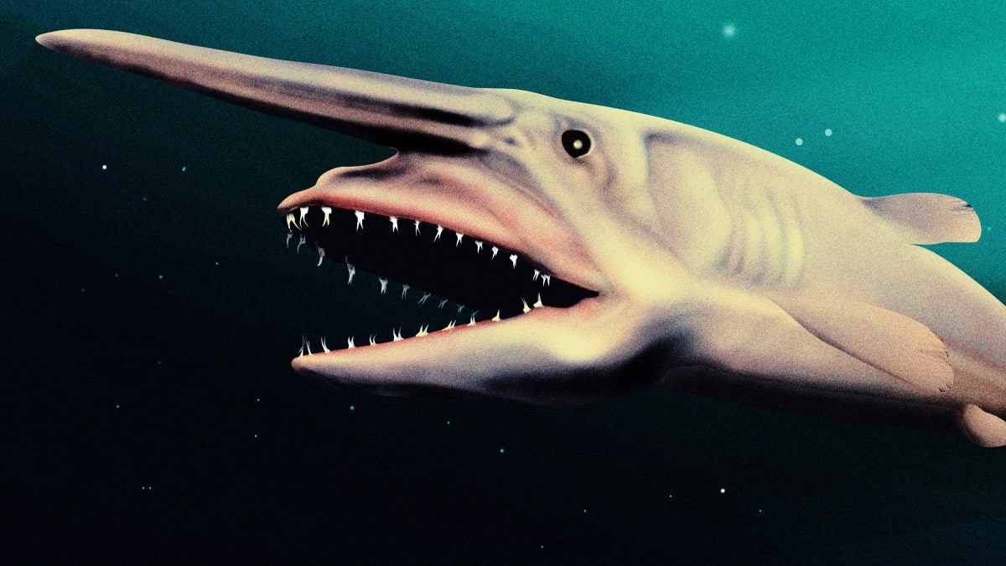
DEEP OCEAN TRENCHES; Adaptations
Angler fish
Sea cucumber
Goblin shark

Slide 10
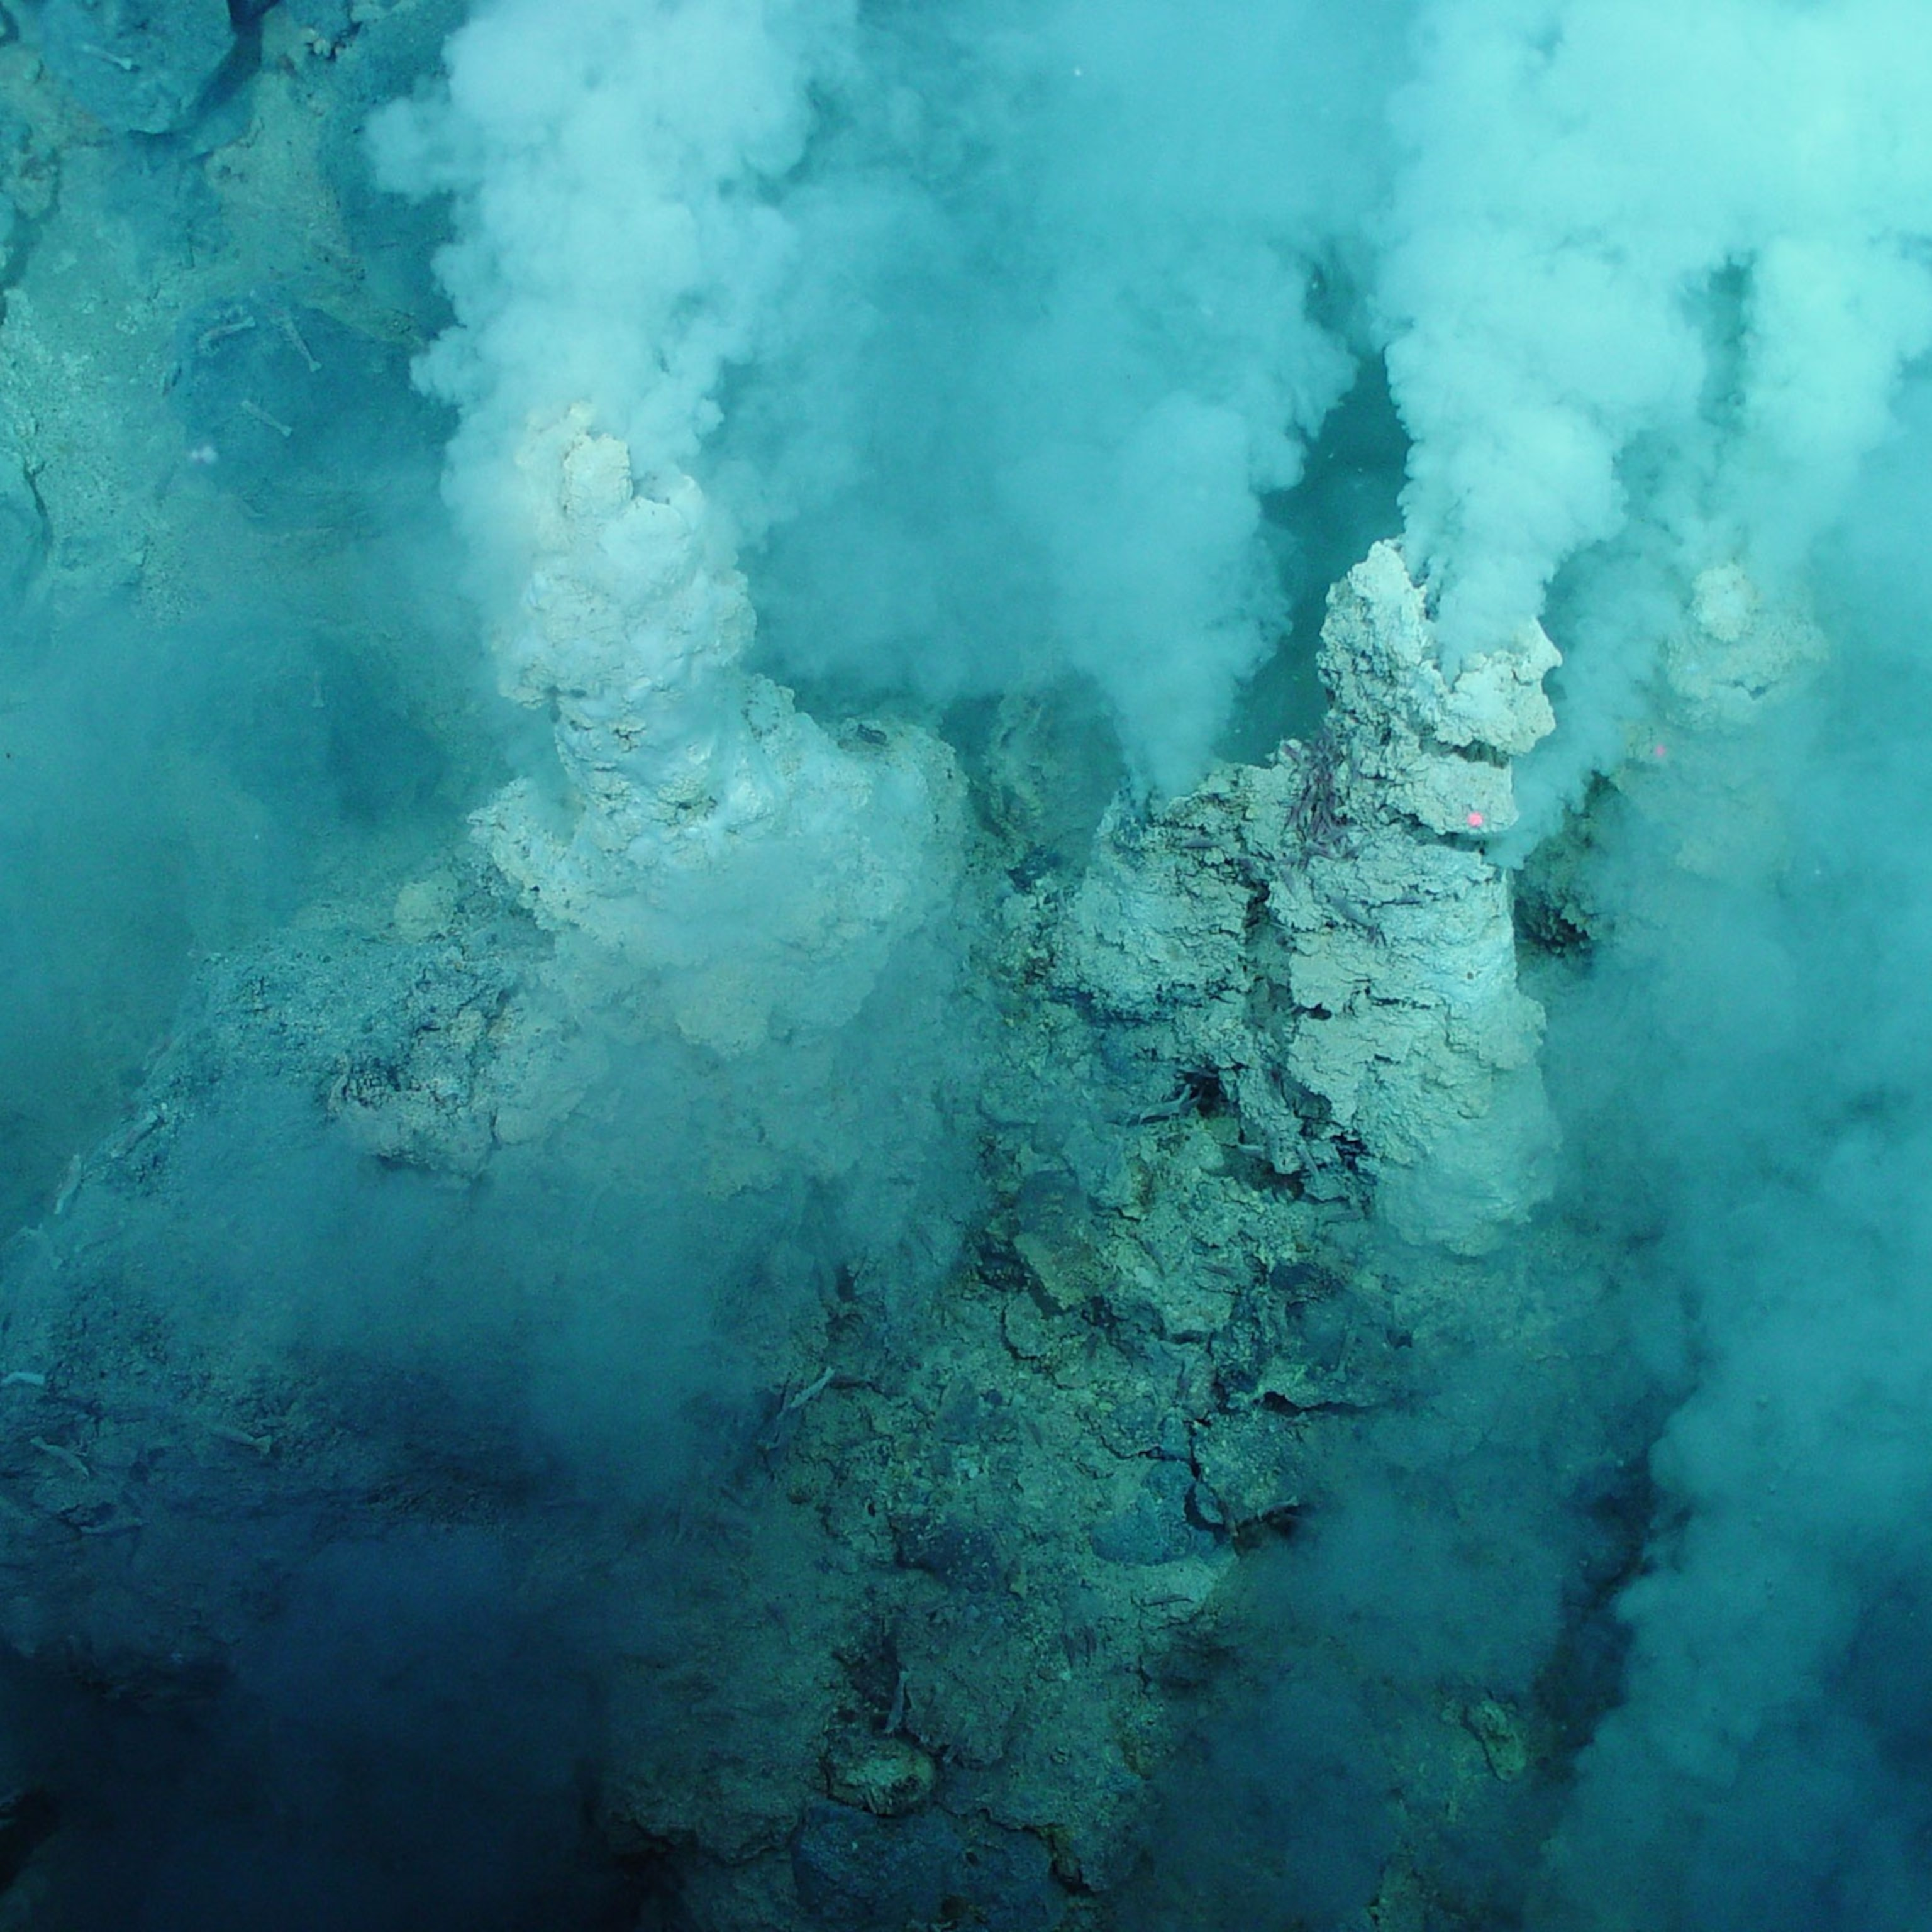
HYDROTHERMAL VENTS

Slide 11
HYDROTHERMAL VENTS; What are they?
Fissures on the seabed or on land from which geothermally heated water discharges.
Usually found in volcanically active places and areas where tectonic plates are moving apart.
Have a density of organisms 10,000 – 100,000 times greater than surrounding sea floor.
E.g. Mammoth Hot Spring in South Dakota.

Slide 12
HYDROTHERMAL VENTS; Features
High temperature (60 0C – 140 0C)
High hydrostatic pressure

Slide 13
HYDROTHERMAL VENTS; Adaptations
Chemotropism. E.g. Sulphur bacteria
Extremozymes E.g. Thermus aquaticus
Special symbiotic relationships. E.g. Tubeworms and Sulphur bacteria

Slide 14
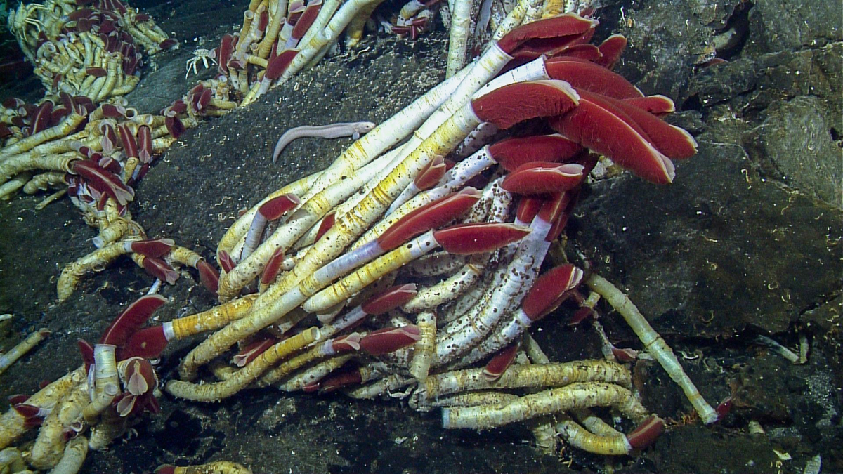
HYDROTHERMAL VENTS; Adaptations
Tubeworms

Slide 15
HYPERSALINE LAKES; What are They?
It is a landlocked body of water that contains significant concentrations of NaCl and other salts, with salinity levels surpassing that of ocean water (35%)
E.g. Dead Sea and the Great Salt Lake in Utah.

Slide 16
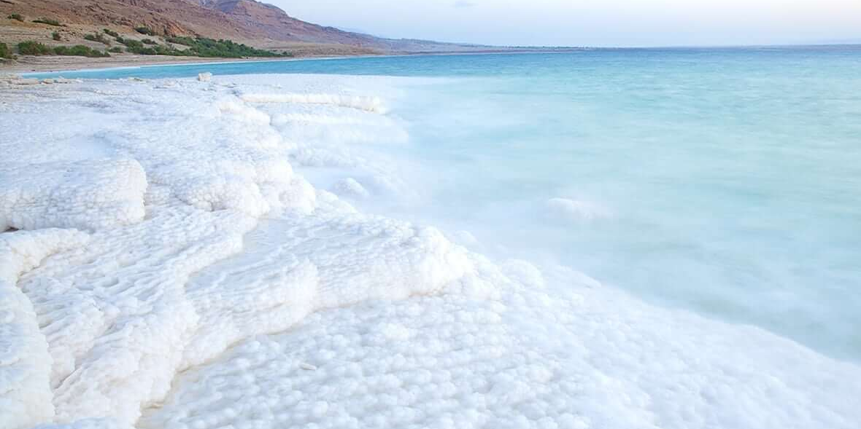
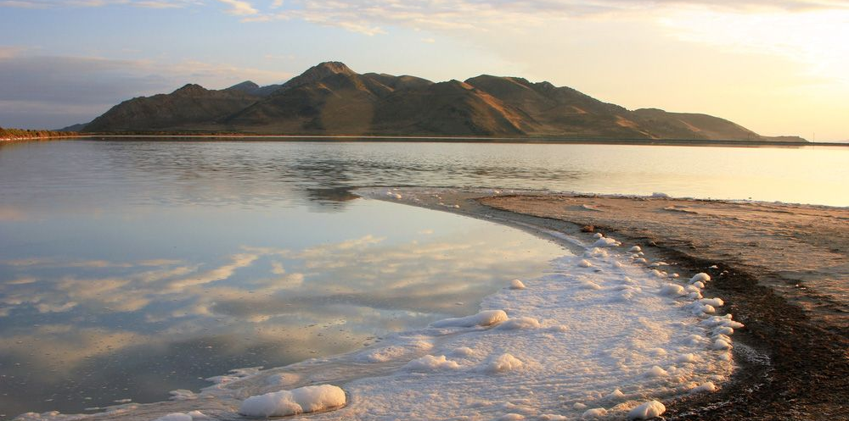
HYPERSALINE LAKES; What are they?
The Dead Sea
The Great Salt Lake, Utah

Slide 17
HYPERSALINE LAKES; Features
High osmotic pressure
High density

Slide 18
HYPERSALINE LAKES; Adaptations
Ability to excrete excess NaCl
Ability to concentrate Potassium Chloride to counter the higher osmotic pressure outside the organism
Possession of extremozymes
Examples are Salinibacter ruber and Halobacterium sp.

Slide 19
EPHEMERAL AND INTERMITTENT WATER BODIES; What are they?
Water bodies that have water channels are always above the water table.
Usually fed by direct precipitation such as rain and snow.
They therefore dry up in summer or dry season.

Slide 20
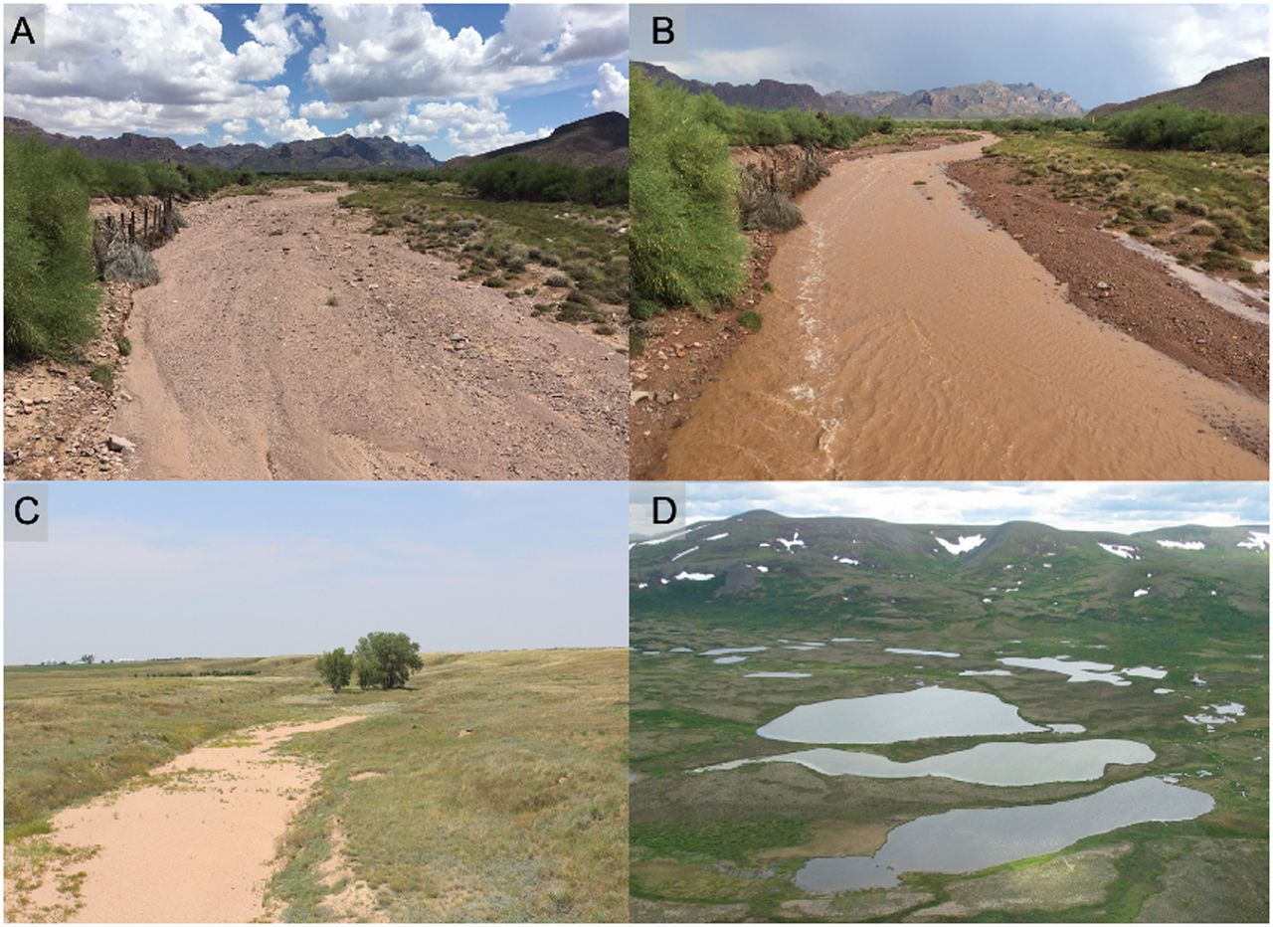
EPHEMERAL AND INTERMITTENT WATER BODIES; What are they?

Slide 21
EPHEMERAL AND INTERMITTENT WATER BODIES; Features
Fluctuation between aquatic and terrestrial conditions.

Slide 22
EPHEMERAL AND INTERMITTENT WATER BODIES; Adaptations
Possession of lungs for gaseous exchange in the absence of water. E.g. African lungfish
Special structures for movement on land . E.g. Walking catfish
Aestivation. E.g. African lungfish (as long as 4 years)
Migration

Slide 23
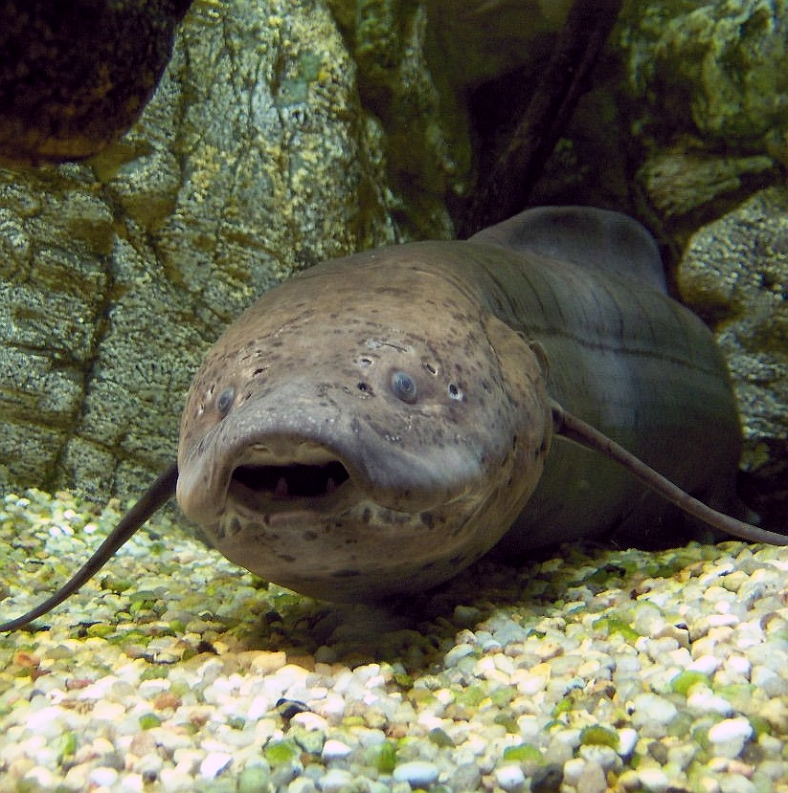
EPHEMERAL AND INTERMITTENT WATER BODIES; Adaptations
The African lungfish

Slide 24
ESTUARIES; What are They?
A place where a lotic water body joins with the salt water of the ocean.
They form a transition zone between river environments and maritime environments.

Slide 25
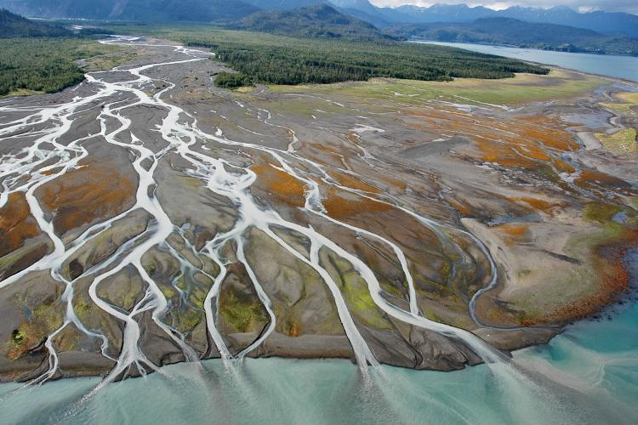
ESTUARIES; What are they?

Slide 26
ESTUARIES; Features
Brackish water (salinity between freshwater and full strength ocean water)
Turbulence

Slide 27
ESTUARIES; Adaptations
Euryhalinity
Avoiding unfavorable salinity conditions.
Pneumatophores for gaseous exchange. E.g. mangroves

Slide 28
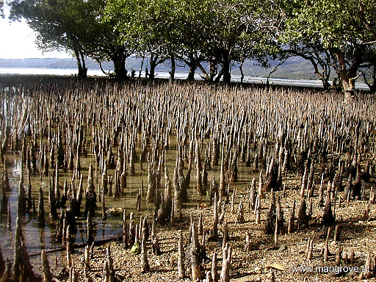
ESTUARIES; Adaptations
Pneumatophores

Slide 29
CONCLUSION
The ability to adapt and thrive in any environment, no matter how extreme, is one of the defining characteristics of life as we know it.
Life on Earth is truly hardy and ubiquitous.

Slide 30
THANK YOU!!!

Slide 31
GROUP 33
KUNYELEWOSI Alexander
ASIEDU Precious
DJONOR Audrey Antonia
BOTCHWEY Bismark
ODAME-LABI Kelvin
AKONNOR Anita Nhyira
OWUSU Tracy Abena Adoma

